Slide 1




.NET Conf 2024 – Ukraine
Vladislav Antonyuk
Rostyslav Skrypnyk

Slide 2
World Explorer – uncovering the World with Every Step!
AI-Powered Exploration
Comprehensive Place Descriptions
Nearby Recommendations
Personalized Experience

Slide 3
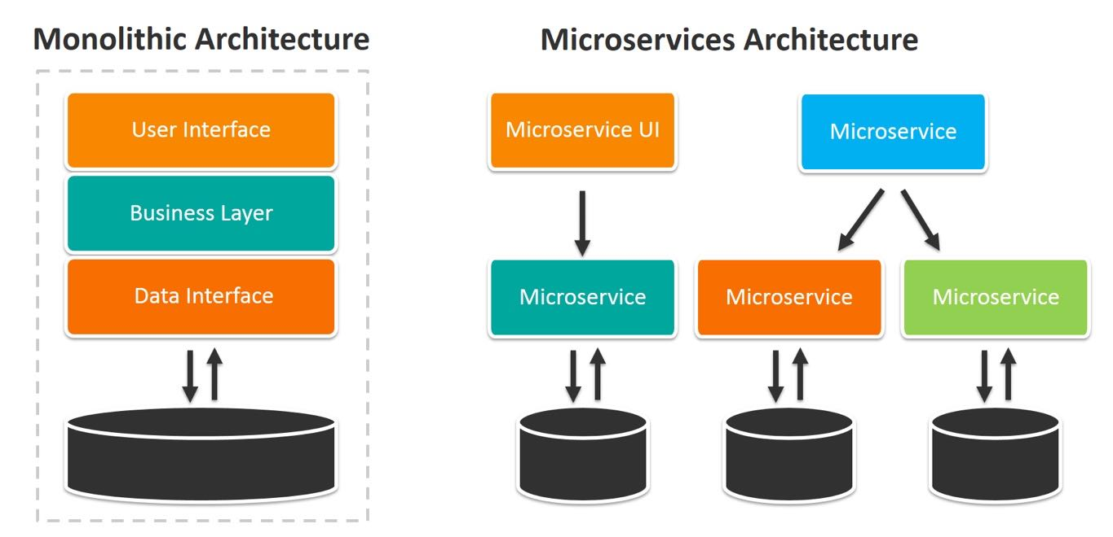
What is software architecture?
It is a decision about the overall structure and behavior of the system
These are decisions that are expensive to change
Monoliths | Microservices
One unit to deploy | Lots of blocks to deploy
Use method calls to communicate | Use network calls to communicate
Scalable, but less efficient use of resources | Horizontally and vertically scalable
Provide immediate consistency | Provide gradual consistency

Slide 4
Advantages of microservices
Scalability Data isolation Autonomy of the organization Independent Deployment Limitations of the area of influence of errors

Slide 5
Microservices first?
It is difficult to define the boundaries of services Boundaries are more difficult to change in a distributed system
"You shouldn't start a new project with microservices, even if you're sure your application will be big enough to justify it." – Martin Fowler

Slide 6
Advantages of monoliths
Simplified deployment Easier transaction management Reduced complexity compared to microservices

Slide 7


Who uses monoliths?
Stack Overflow
Shopify

Slide 8
Modular monolith
This is an approach to software design where a monolith is built with a focus on replaceable (and potentially reusable) modules This is an architectural pattern that structures the application into independent modules (components) with clearly defined boundaries

Slide 9
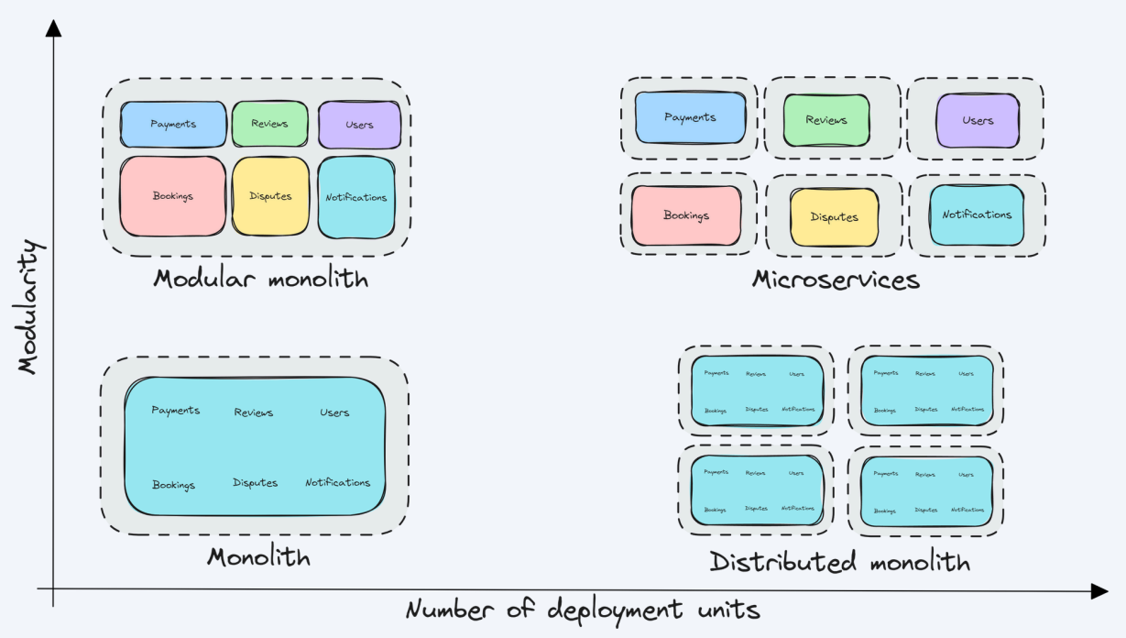
Modular architecture

Slide 10
What is a module?
Modules represent cohesive sets of functionality Each module can be considered as a separate application Modules must be self-contained

Slide 11
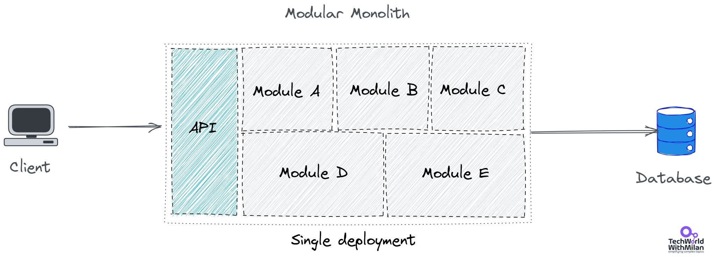
Modular monolith

Slide 12
Advantages of a modular monolith
High cohesion
Loose coupling
Simplified deployment Improved performance Easier transition to microservices

Slide 13
Modular architecture
To achieve a modular architecture, modules must:
be independent and variable provide the necessary functionality have a well-defined interface for other modules

Slide 14
Limitations of modules
Modules must comply with the following restrictions:
Logical isolation between modules Modules must communicate via a public API
Method calls: fast, in-memory Messaging: For weaker binding
Module data must be isolated in the database
Separate tables Separate schemas Separate databases Various databases

Slide 15
What if you need data from another module?
Use direct calls via public API Use messaging Copy data

Slide 16
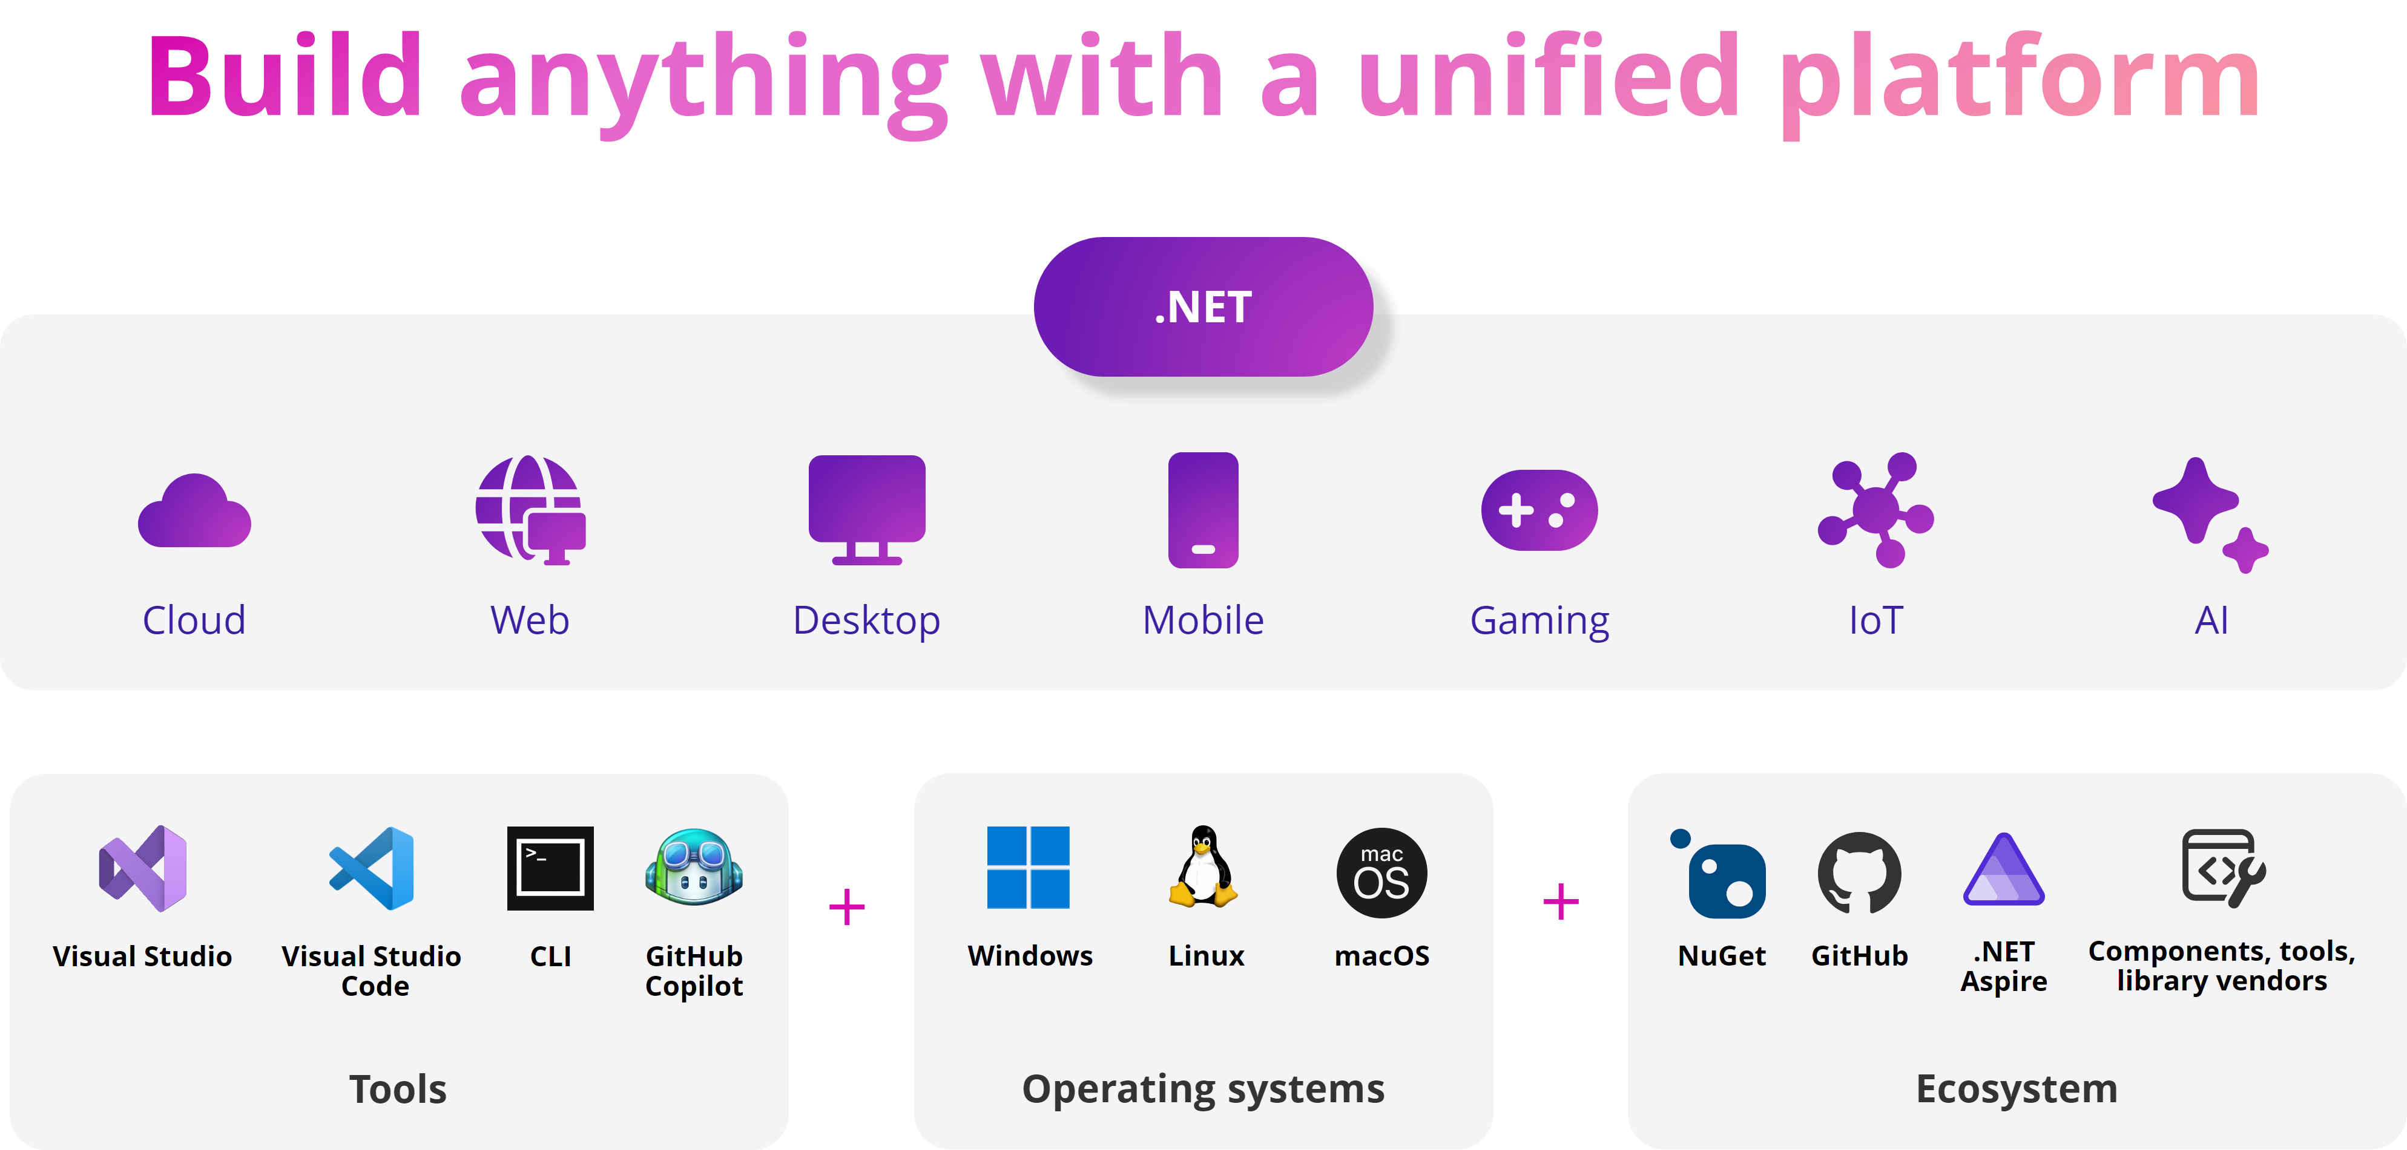
Overview of new .NET 9
https://devblogs.microsoft.com/dotnet/announcing-dotnet-9/

Slide 17
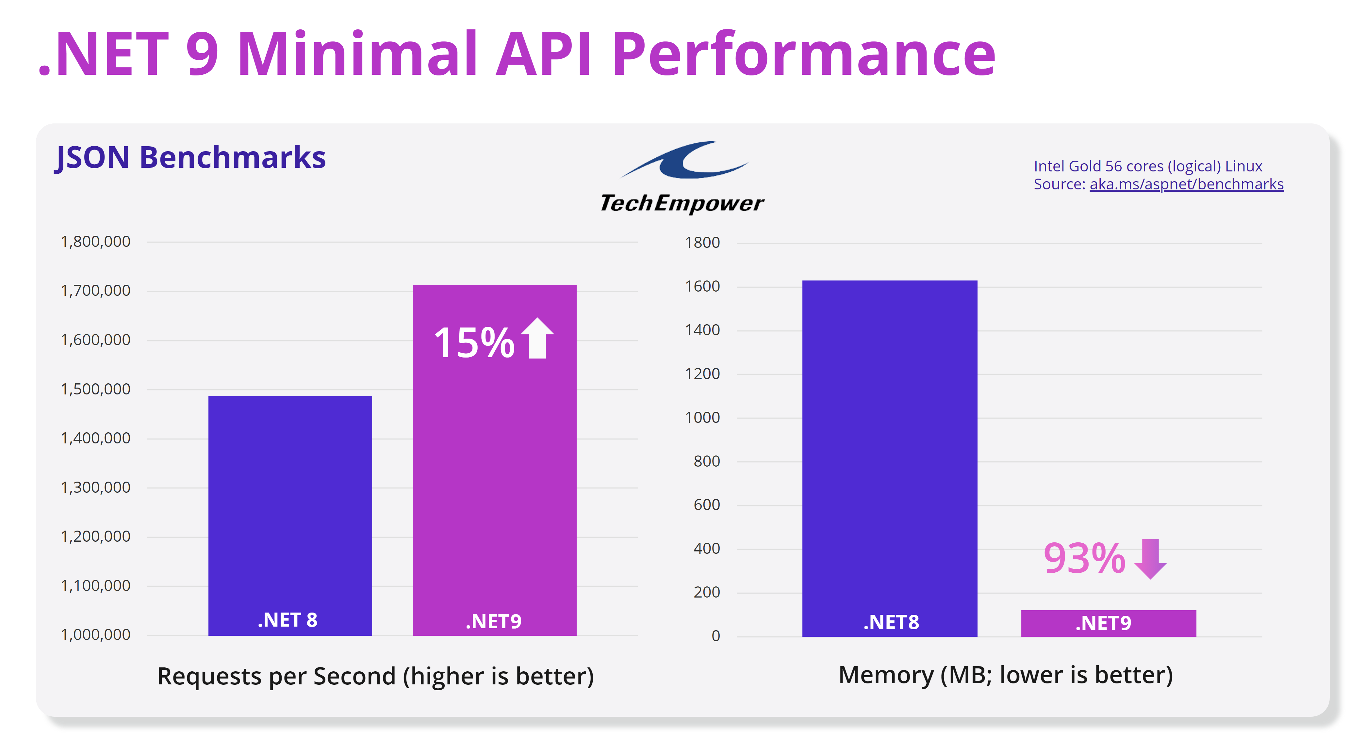
Overview of new .NET 9
https://devblogs.microsoft.com/dotnet/performance-improvements-in-net-9/

Slide 18
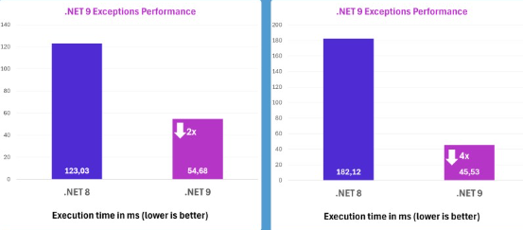
Overview of new .NET 9
Performance improvements in Exceptions

Slide 19
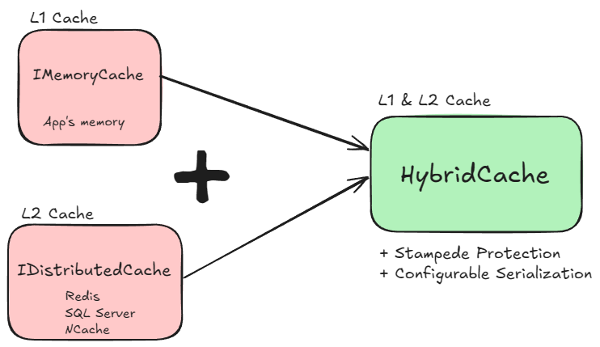
Overview of new .NET 9
New HybridCache

Slide 20
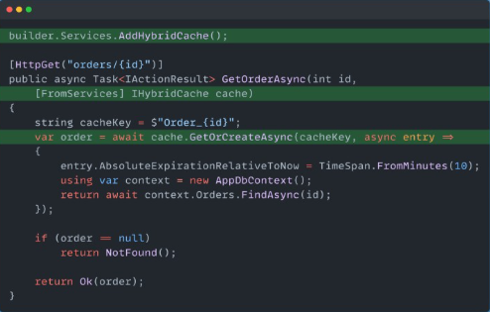
Overview of new .NET 9
New HybridCache

Slide 21
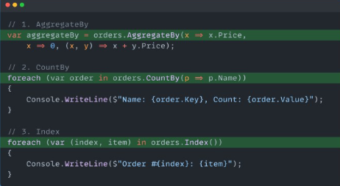
Overview of new .NET 9
New LINQ methods

Slide 22
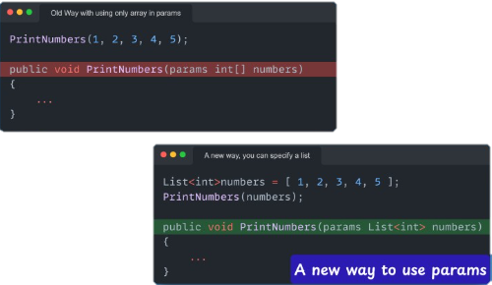
Overview of new .NET 9
C# 13 Params Collection

Slide 23
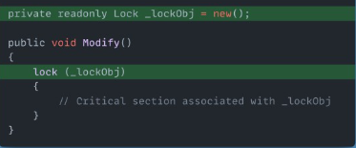
Overview of new .NET 9
C# 13 New Lock Class

Slide 24
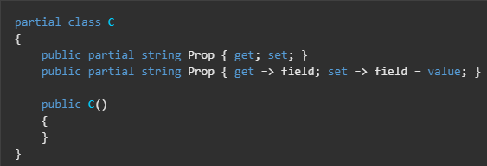
Overview of new .NET 9
C# 13 Partial Properties

Slide 25
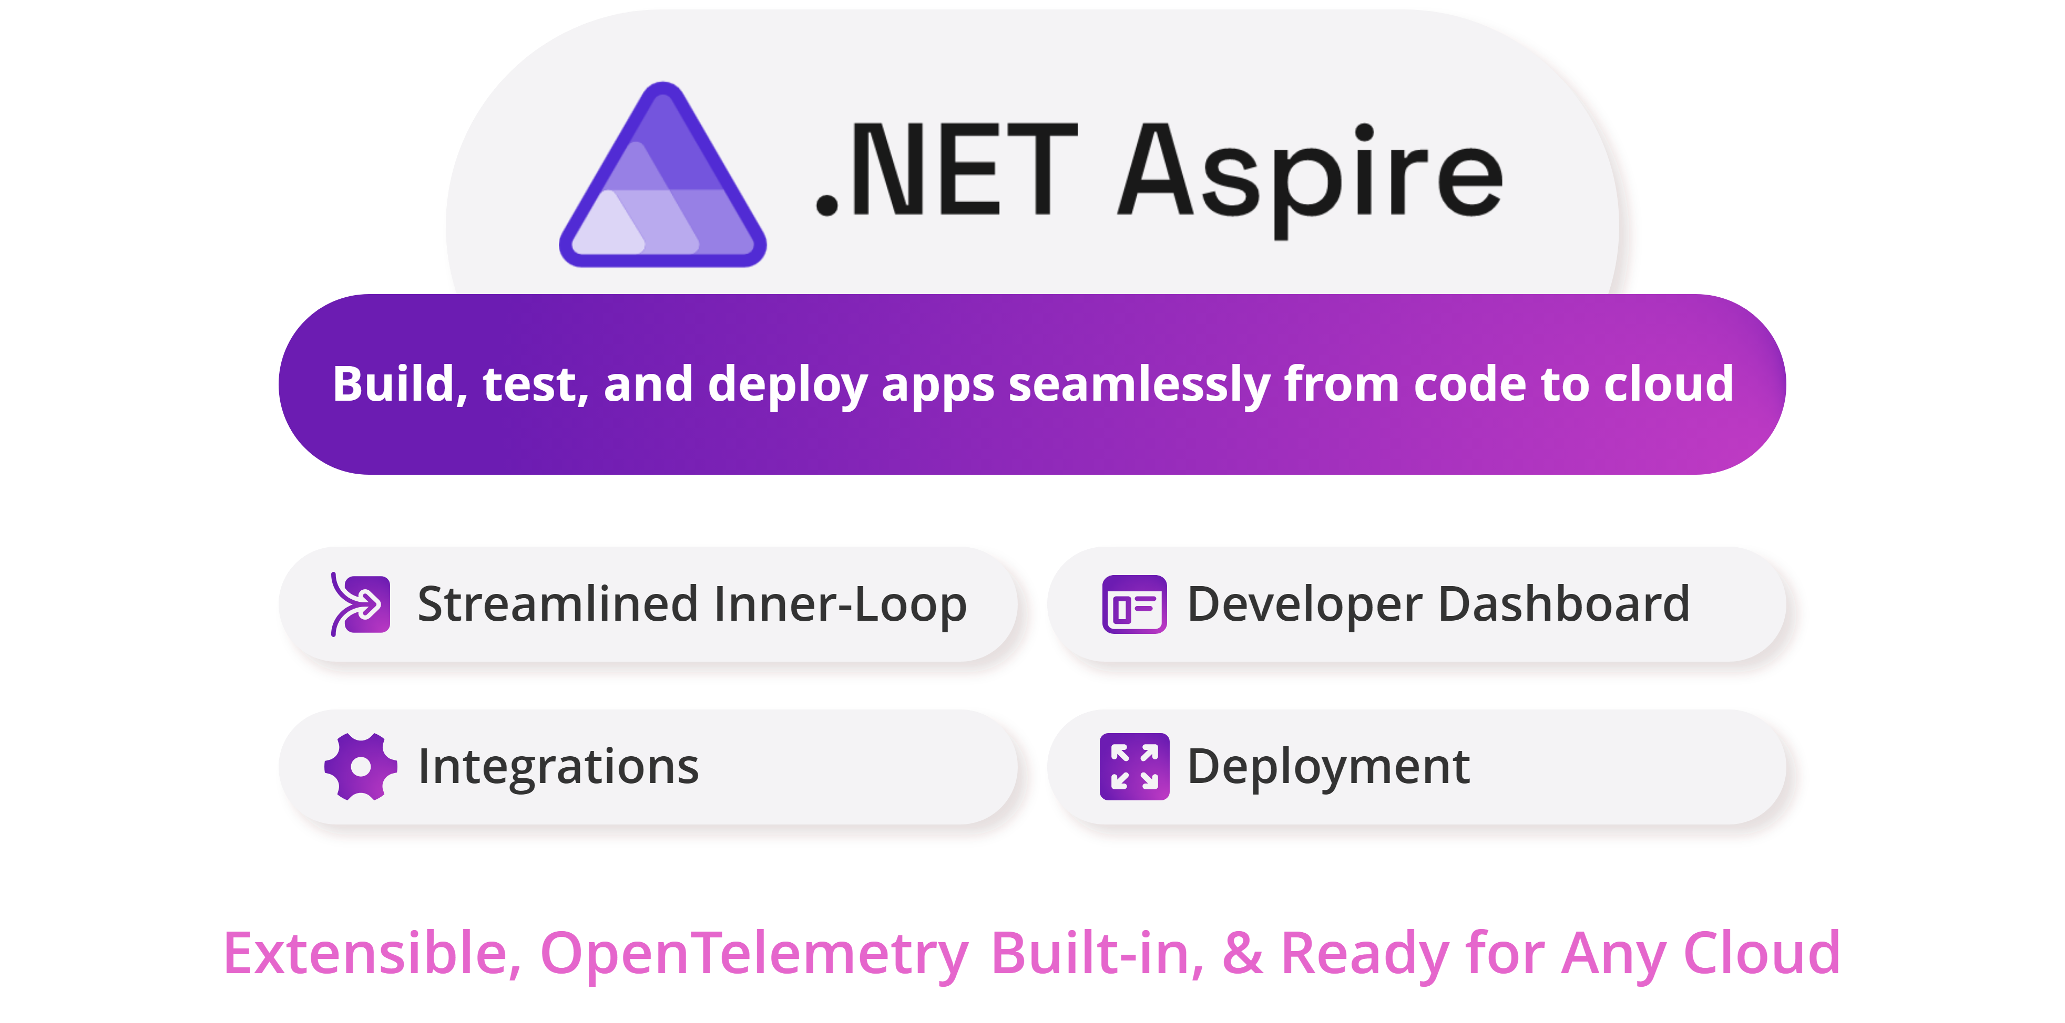
Overview of .NET ASPIRE

Slide 26
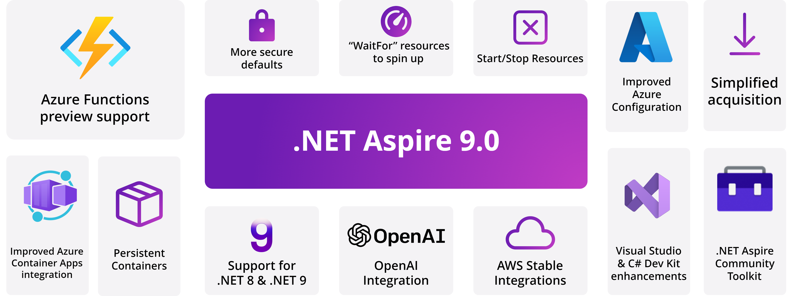
Overview of .NET ASPIRE

Slide 27

EF Core and Spatial Data

Slide 28



Cross-platform frameworks for UI
.NET MAUI | Uno Platform | Avalonia UI

Slide 29
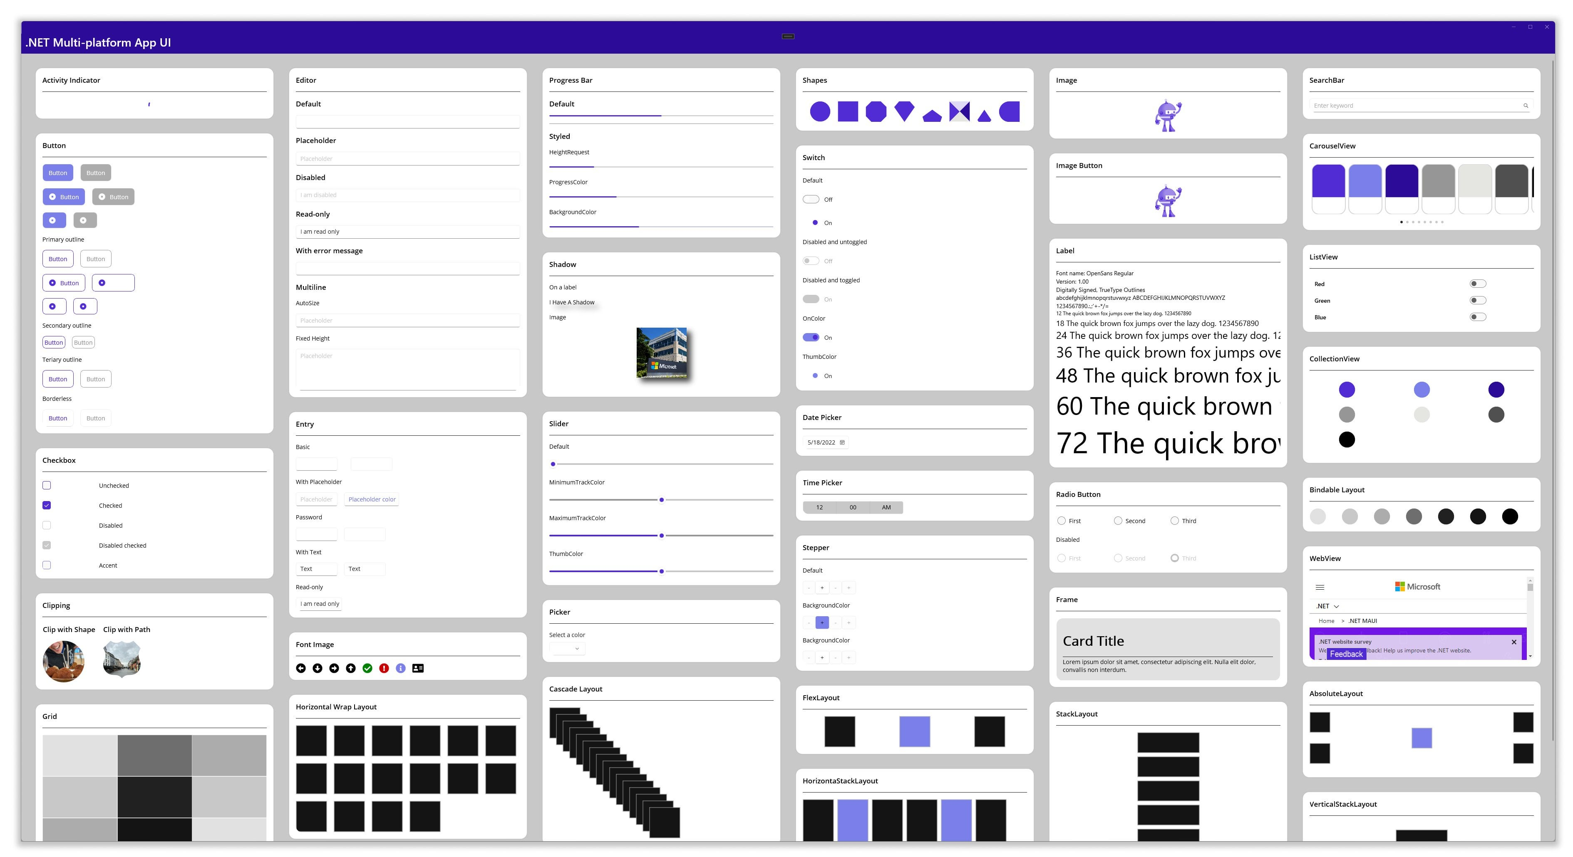
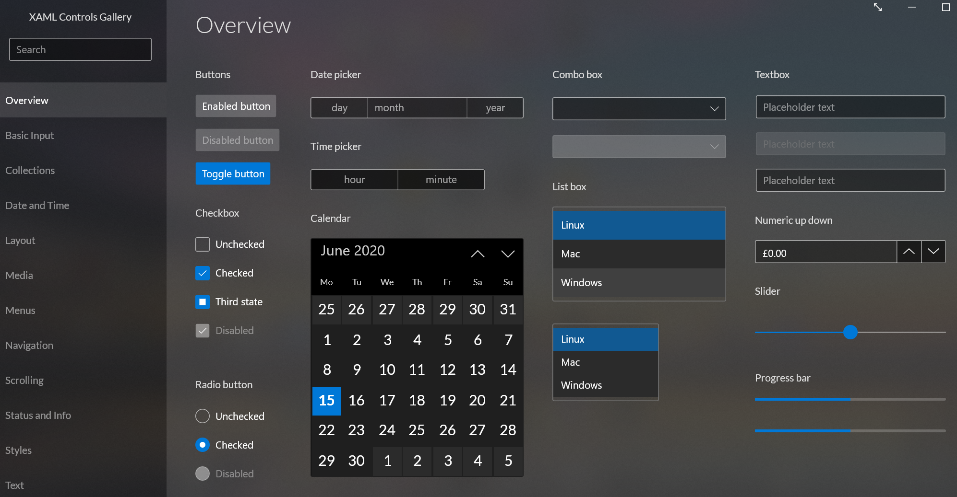
Cross-platform frameworks for UI

Slide 30
Cross-platform frameworks for UI
.NET MAUI
Uno Platform – .NET MAUI Embedding
Avalonia UI – AvaloniaMauiHybrid

Slide 31
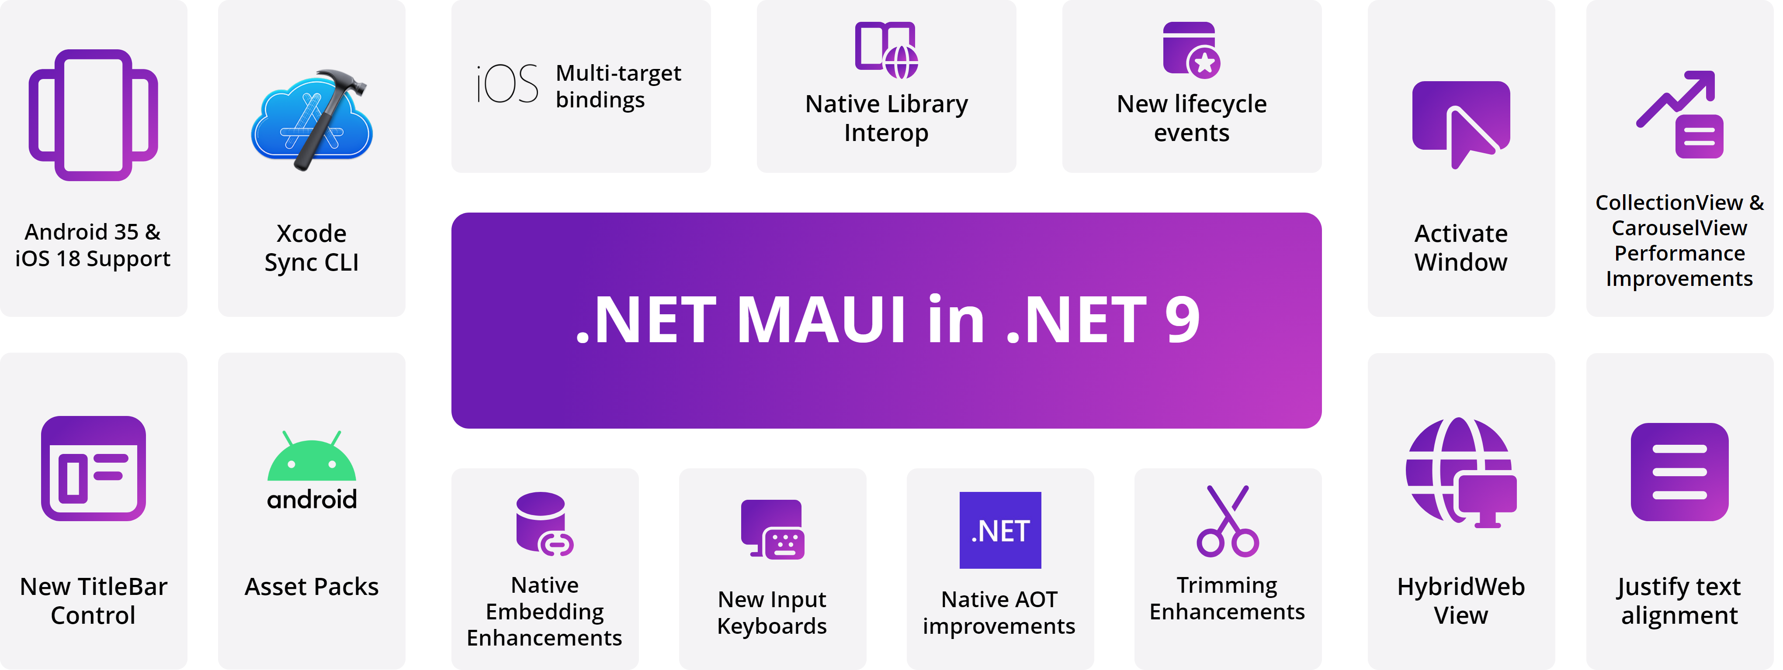
Cross-platform frameworks for UI

Slide 32
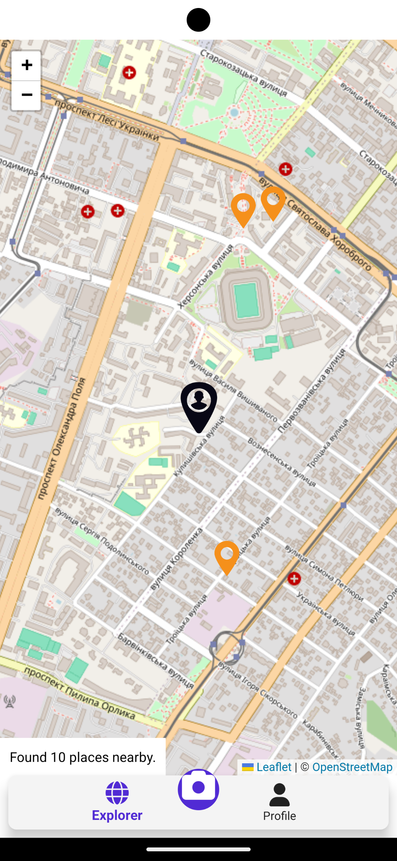
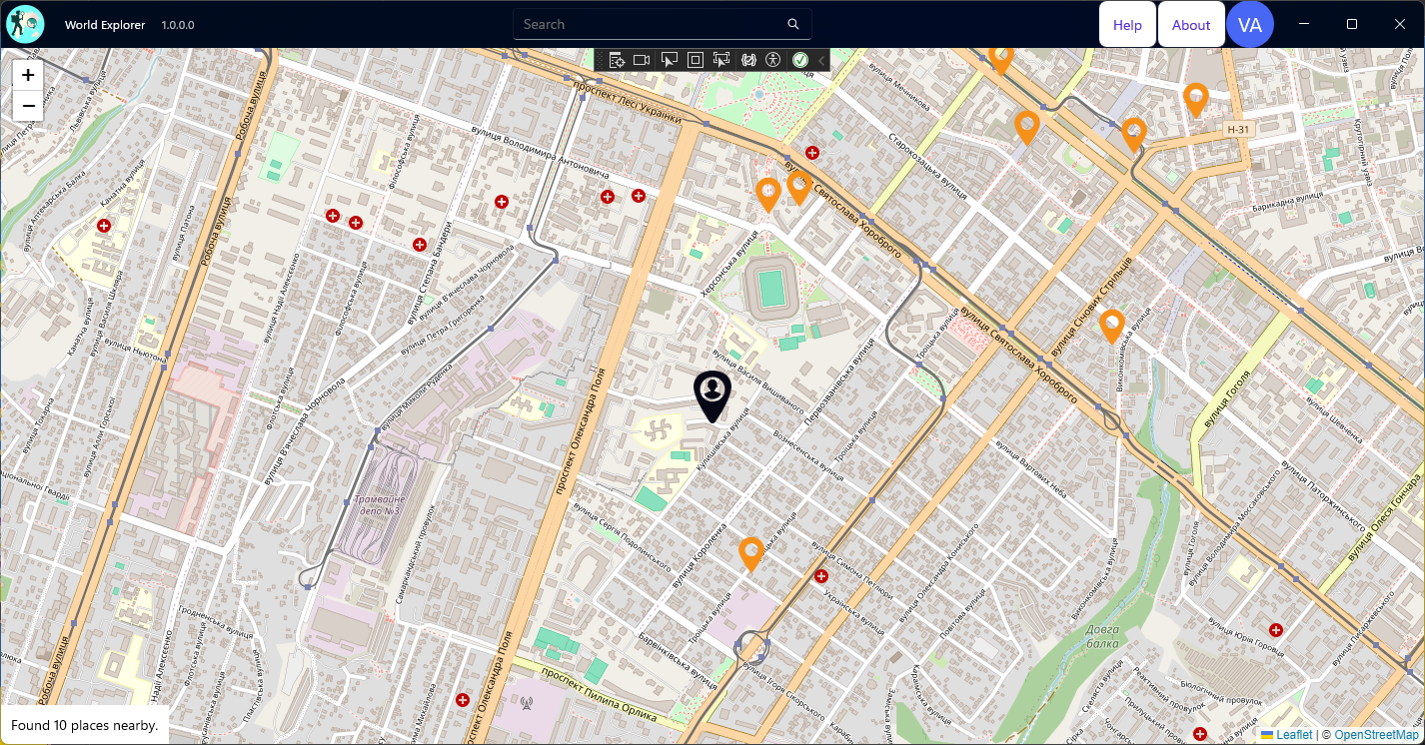
World Explorer – Map Control

Slide 33
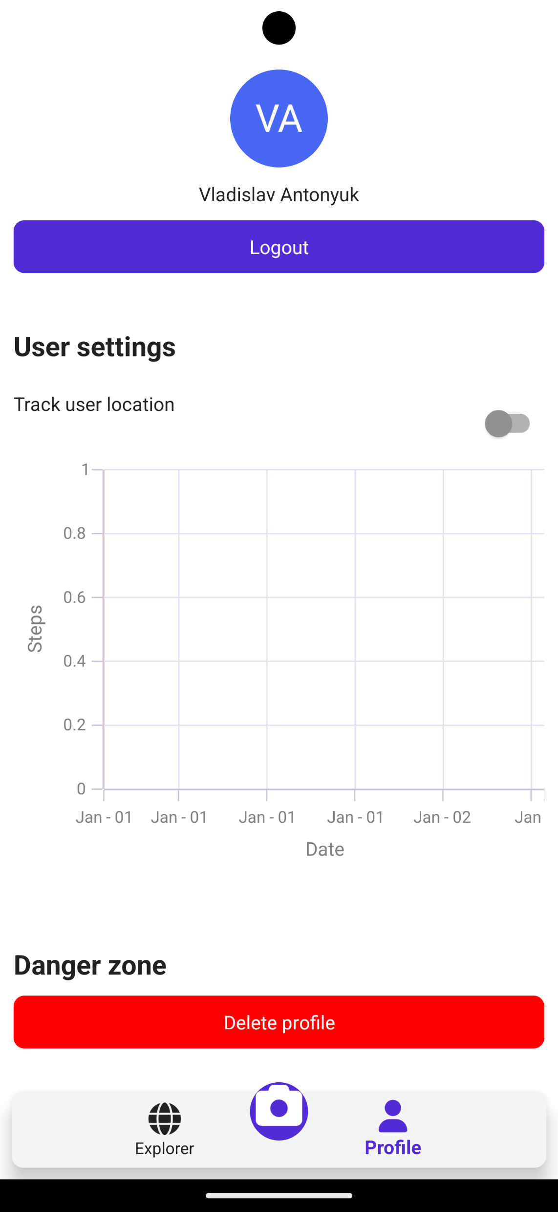
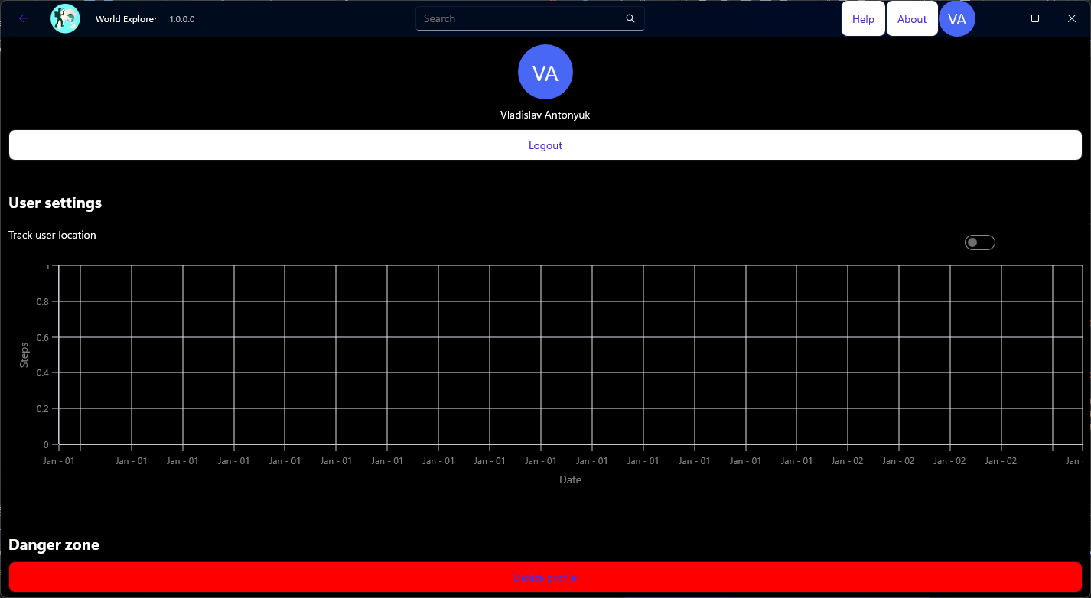
World Explorer – Light and Dark Theme

Slide 34
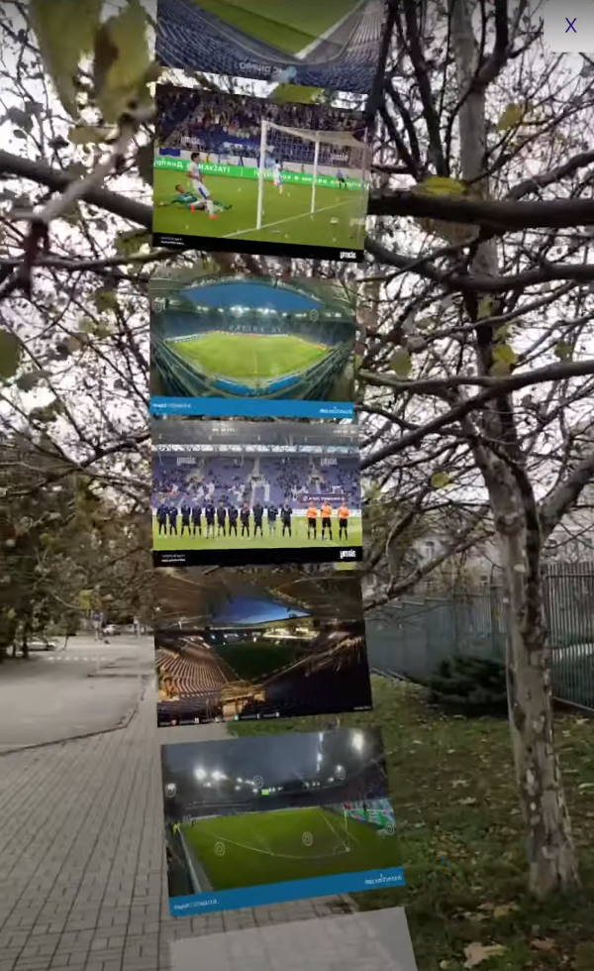

World Explorer – ARView control

Slide 35
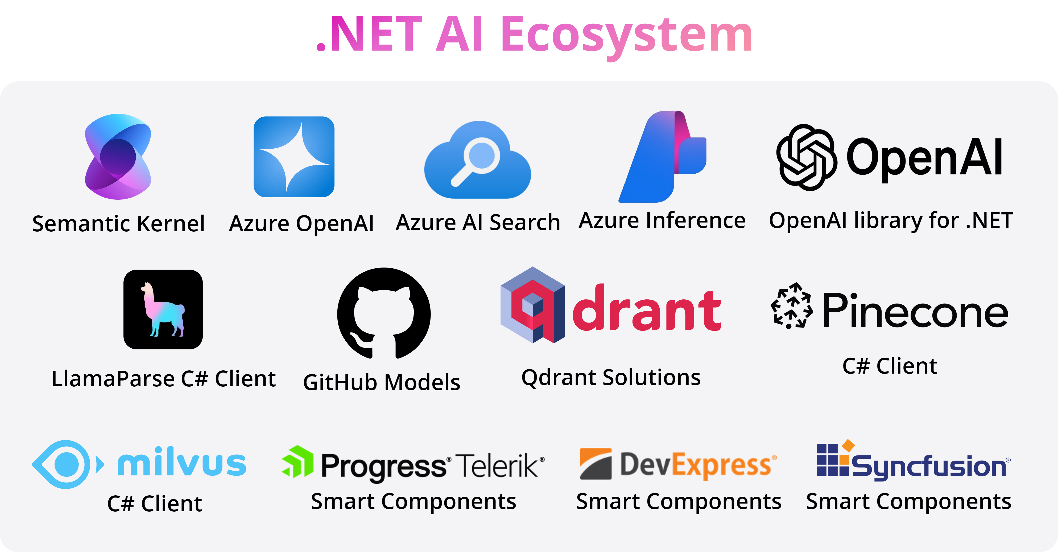
Artificial Intelligence and .NET

Slide 36
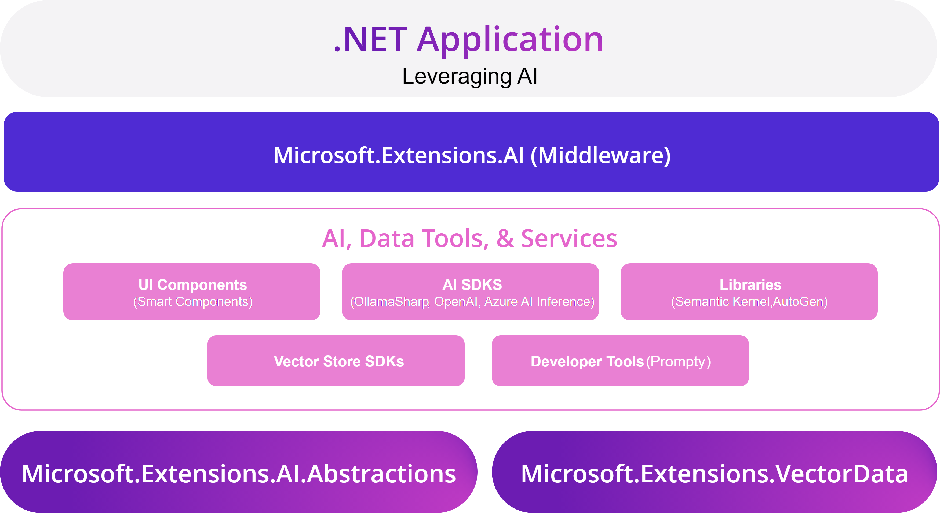
Artificial Intelligence and .NET

Slide 37

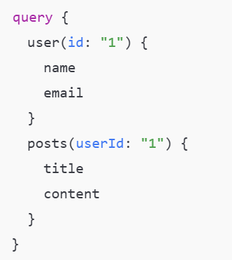
GraphQL and .NET

Slide 38
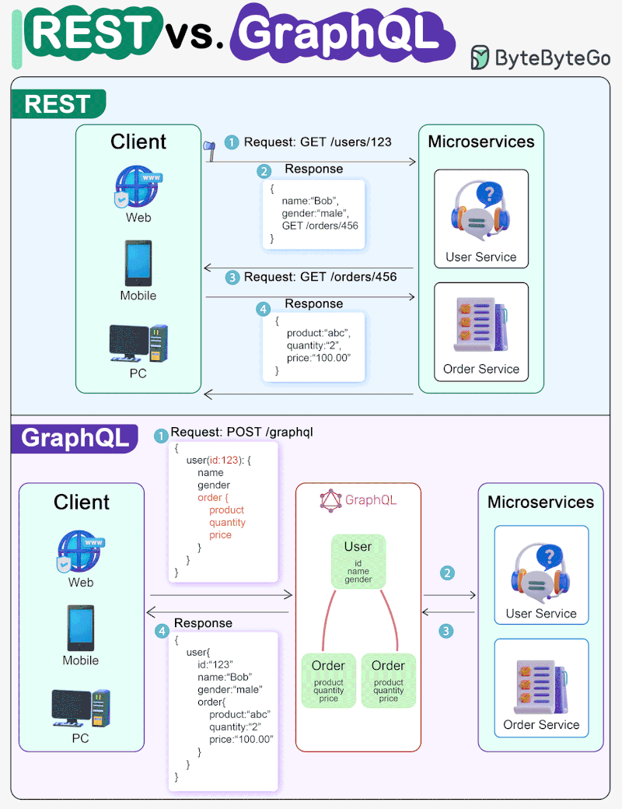
GraphQL vs REST API
REST API | GraphQL
Each endpoint is responsible for a specific resource. Uses HTTP methods (GET, POST, PUT, DELETE). | One endpoint for all requests, the client forms a request for his needs.
Different data requires multiple queries to different endpoints. | Several queries are combined into one, the data is selected selectively.
Returns a fixed set of data, even if only a portion is needed. | The client requests only those fields that are needed, without unnecessary data.
Passes all endpoint data, even if the client only needs a few fields. | Passes only the requested fields, which reduces the amount of data.
There is no hard typing, changes to the server can affect clients. | A well-defined scheme with the verification of requests and responses.

Slide 39
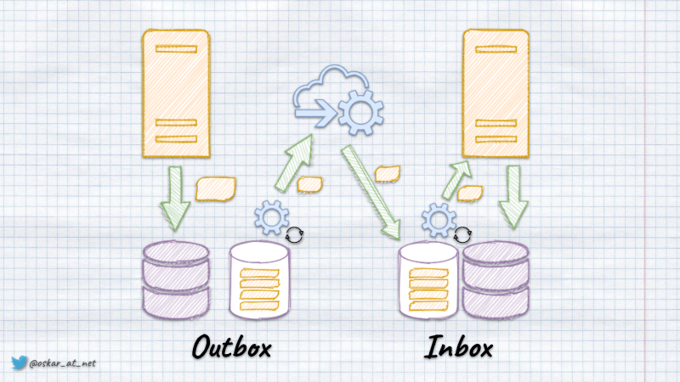
Inbox/Outbox Mechanisms

Slide 40
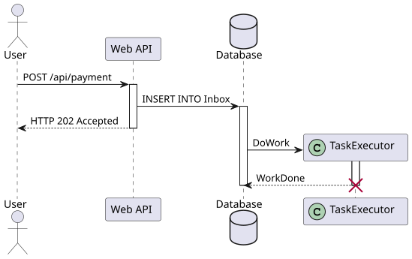
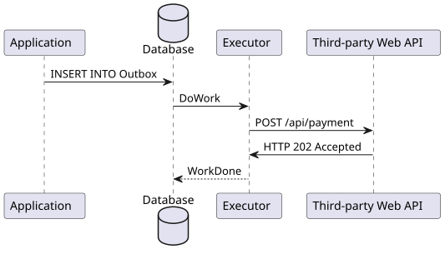
Inbox/Outbox Mechanisms
Outbox | Inbox
Ensures that the message has been successfully sent at least once. | Ensures that the message has been successfully received at least once.

Slide 41

Deployment and release to marketplaces

Slide 42
Links and Samples
World Explorer
Modular Monolith Architecture
.NET 9 Overview
.NET Aspire docs
Spatial Data
.NET MAUI docs
.NET AI Overview
Strawberry Shake Graph QL

